Slide 1
Journal club
แพทย์ประจำบ้านปี2 กิตติพิชญ์ อุลิศ
อาจารย์ นพดล ชื่นศิริเกษม

Slide 2
postoperative Sleep-Disordered Breathing in Patients Without Preoperative Sleep Apnea
Anesthesia Analgesia • June 2015 • Volume 120 • Number 6

Slide 3
Background

Slide 4
Sleep-disordered breathing (SDB)
The mildest
Respiratory effort-related arousals (RERA)
Upper airway resistance syndrome
The most severe
Obstructive sleep apnea
Obstructive apneas and hypopneas

Slide 5
Sleep-disordered breathing (SDB)
Prevalence of moderate to severe SDB
Apnea-hypopnea index >15 events/h
17% in 50-70 year old men and 9% in 50-70 year old women
The prevalence of SDB in surgical patients
vary with different surgical populations: 7-8%
May be under estimated because of clinical diagnosed and mostly found in morbidly obese patients

Slide 6
Sleep-disordered breathing (SDB)
Significant clinical implications
more sensitive to general anesthetics and narcotics
increase in upper airway collapsibility
postoperative upper airway obstruction
more likely to receive ventilatory support
use more intensive care, step-down, and telemetry services
consume more economic resources
longer hospital stay

Slide 7
Sleep-disordered breathing (SDB)
Postoperative AHI was significantly increased in some patients without preoperative sleep apnea (non–sleep apnea)
increased risk for SDB-related perioperative adverse events

Slide 8
Objective
To investigate the incidence of postoperative moderate-to-severe SDB (AHI > 15 events/h) in patients without sleep apnea based on preoperative polysomnography (AHI ≤ 5 events/h)
To explore predictive factors associated with an increase in the AHI in this subset of patients

Slide 9
Hypothesis
In non–sleep apnea patients, clinical characteristics and parameters from preoperative polysomnography may be predictive of the postoperative occurrence of moderate-to-severe SDB

Slide 10
Methods

Slide 11
Study design
Prospective observational design without any interventions
Approvals from Institutional Review Boards were obtained from University Health Network and Mount Sinai Hospital, both at Toronto (UHN: 06-0135-AE and 07-0515-AE; MSH: 06-0143-E and 07-0183-E)

Slide 12
Study subjects
All patients
18 years or older
ASA physical status I to IV
scheduled for elective surgical procedures
Excluded patients
unwilling or unable to give informed consent
expected to have abnormal EEG findings (e.g., brain tumor, epilepsy surgery, patients with deep brain stimulators)

Slide 13
Patient recruitment and follow up
Preoperative visit for informed consent
Consented patients underwent sleep studies with a 10-channel portable polysomnography device (Embletta X100, Embla, Broomfield, CO)
A full-night polysomnography with Embletta X100 was performed,
preoperatively at home
postoperative night 1 and 3 in the hospital or at home
At bedtime, a sleep technician connected the portable polysomnography device at patient and retrieved it back the following morning

Slide 14
Patient follow up
The recordings from the portable polysomnography were scored by a certified polysomnographic technologist and reviewed by a sleep physician
Parameters recorded
Apnea index
Hypopnea index
AHI
REM sleep AHI and Non-REM sleep AHI
RDI
RERAs
Respiratory arousal index
Oxygen desaturation index
CT90

Slide 15
Patient follow up
all polysomnography recordings were scored after the patients were discharged from the hospital
The anesthesiologists and the surgeons caring for the study patients were blinded
the health care team provided routine care to their patients

Slide 16
The patient classification
Non–sleep apnea patients
AHI ≤ 5 events/h on the preoperative home polysomnography
Postoperative SDB group
AHI > 15 events/h on postoperative night 1 or night 3
Postoperative non-SDB group
AHI ≤ 15 events/h on both postoperative night 1 and 3

Slide 17
Anesthesia and Postoperative Pain Control
A balanced anesthetic technique was used in all patients
General anesthesia
Regional anesthesia
Both groups received a narcotic in the postoperative period

Slide 18
Anesthesia and Postoperative Pain Control
All patients were reviewed twice daily by the Acute Pain Service team
IV morphine PCA was initiated when the verbal pain score was ≥4
Increased the immediate-release oxycodone dose and/or added controlled-release oxycodone to achieve a verbal pain score of 4 or less for pain
The clinical decision of oxygen therapy or CPAP therapy was made by the perioperative care team
if SpO₂ on oximeter monitoring is less than 94%

Slide 19
Sample size estimation
The simulation studies demonstrated that logistic regression models require 10 or more cases with events per predictor to produce stable estimates.
If include 3 predictors with a prevalence of postoperative moderate-to-severe SDB of 26%, the estimated sample size would be 10x(3/0.26)=115 or more

Slide 20
Data analysis
SAS 9.3 for Windows (SAS Institute, Cary, NC) was used for data analysis
All the statistical tests are 2-tailed tests, and P < 0.05 or adjusted P < 0.05 was accepted as statistically significant

Slide 21
Data analysis
Categorical data
Presented as frequency with percentage
The statistical significance was checked by χ2 test or Fisher exact test
Continuous data with normal distribution
The mean +/- SD was used
The statistical significance was checked with Student independent 2-sample t test

Slide 22
Data analysis
Continuous data with skewed distribution
The median (25th, 75th percentile) was used
Mann-Whitney U test was used to check the statistical significance
Multiple comparisons among the correlated variables
The Holm-Bonferroni method was used to adjust P value

Slide 23
Data analysis
The perioperative change was the difference in values between postoperative polysomnography and preoperative baseline
Potential risk factors were first evaluated with univariate logistic regression, the correlation between the significant factors was checked, and then multivariate analysis

Slide 24
Data analysis
The optimal cutoff, sensitivity privilege cutoff, and specificity privilege cutoff value were also explored
The mean : the optimal cutoff value
the lower limit of 95% CI: the sensitivity privilege cutoff value
the upper limit of 95% CI : the specificity privilege cutoff value

Slide 25
Data analysis
At the gray zone (inconclusive zone)
a value in the privilege sensitivity side of gray zone :low risk
a value in the gray zone or inconclusive area :intermediate risk
a value in the privilege specificity side of gray zone :high risk

Slide 26
Data analysis
The exact binomial confidence interval method
The 95% confidence interval of sensitivity, specificity, positive predictive value and negative predictive value for the cutoffs

Slide 27
Results

Slide 28
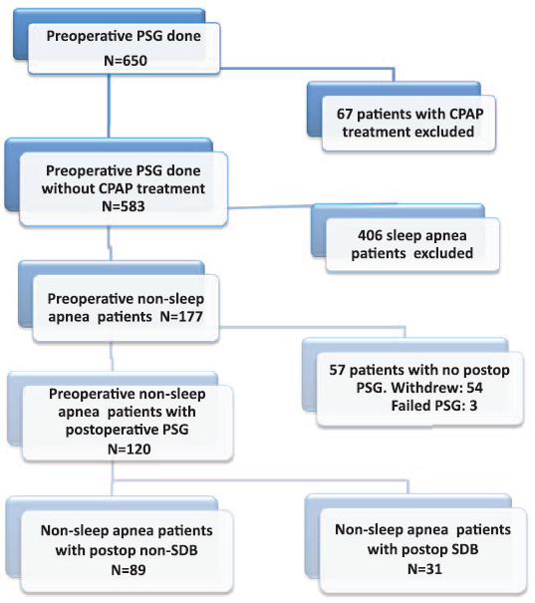
74%
25.8%

Slide 29
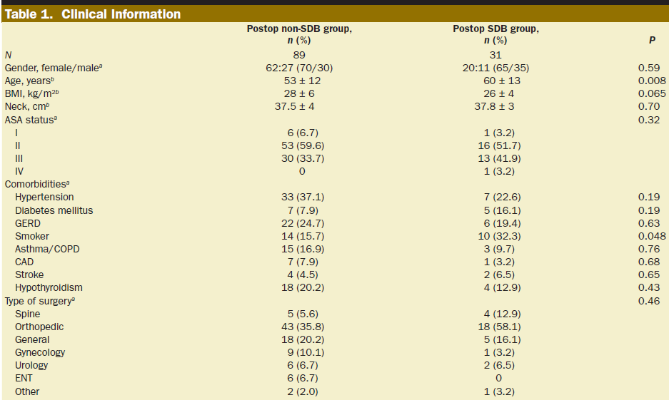
Clinical data

Slide 30
Clinical data

Slide 31
Oxygen saturation and oxygen therapy

Slide 32
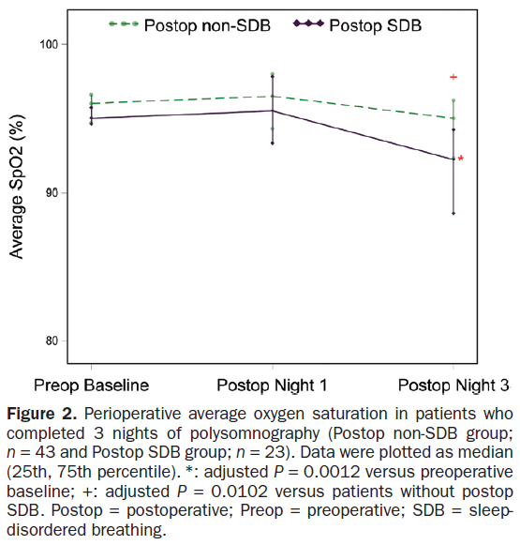

Slide 33
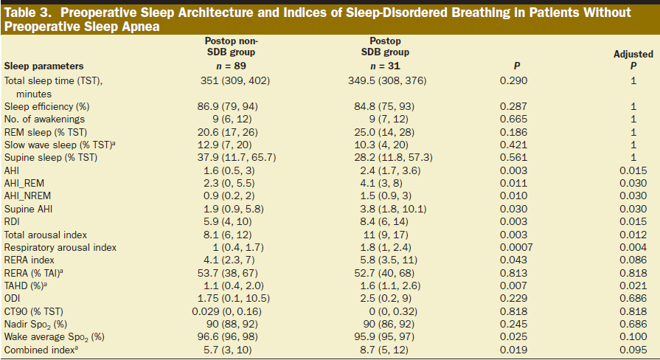
Preoperative baseline study parameters

Slide 34
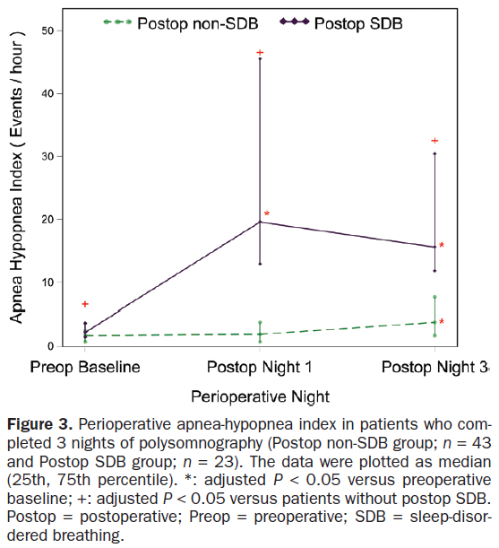

Slide 35
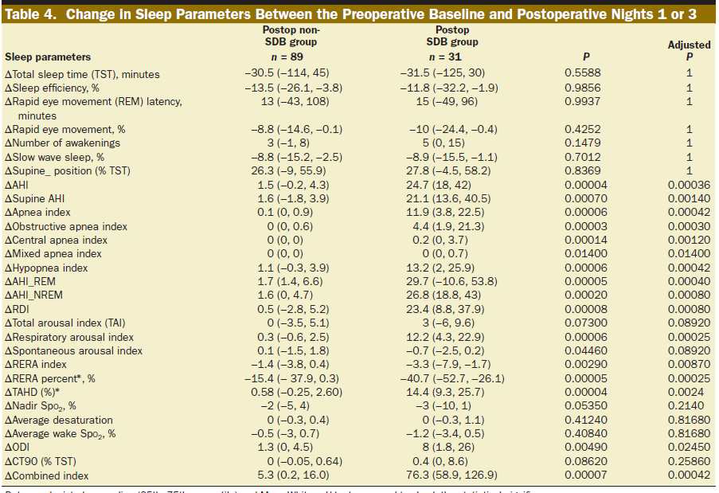
Changes in sleep study parameters

Slide 36
Factors Associated with Postoperative SDB
From univariate logistic regression
Age
preoperative AHI
preoperative RDI
total arousal index
respiratory arousal index
RERA index
awake average Spo2
sleep average Spo2
They were found to be significantly associated with the occurrence of postoperative moderate-to-severe SDB

Slide 37
Factors Associated with Postoperative SDB
From multivariate logistic regression analysis

Slide 38
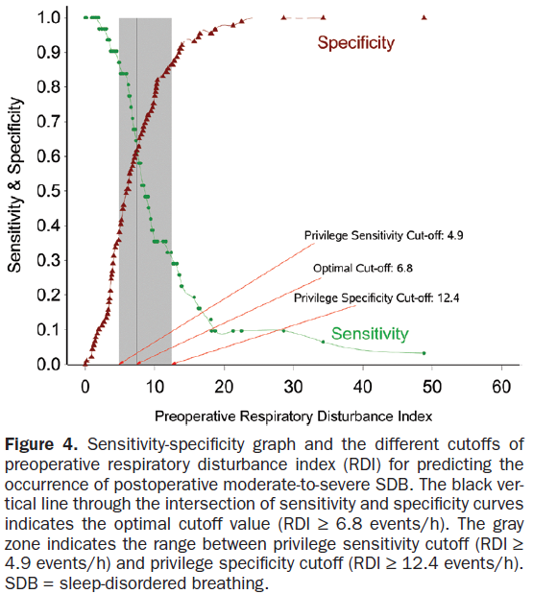

Slide 39
Predicting Postoperative Moderate-to-Severe SDB

Slide 40
Discussion

Slide 41
Discussion
In 120 non–sleep apnea patients, 25.8% developed moderate-to-severe SDB during the postoperative period
mainly driven by obstructive apneas and hypopneas
Analysis also found that RDI, which is equivalent to AHI + RERA, was associated with the occurrence of postoperative SDB

Slide 42
Discussion
Higher preoperative RDI and age were significantly associated with postoperative moderate-to-severe SDB
The sensitivity privilege cutoff at RDI ≥ 4.9 events/h was able to identify 87.1% of patients postoperative moderate-to-severe SDB

Slide 43
Discussion
One night of polysomnography in the preoperative period may not necessarily reflect what will happen postoperatively
Fluid shifts or medications (i.e., opioids or sedatives) may increase the AHI
Age seems to be a significant factor affecting fluid accumulation in the neck in to a saline bolus infusion

Slide 44
Limitation
Only one preoperative polysomnography was performed
Because of the small sample size, we could not examine the effect of postoperative SDB on the incidence of perioperative adverse events
The analysis on prediction of postoperative moderate-to-severe SDB was preliminary. The results need to be validated in other cohorts

Slide 45
Conclusions

Slide 46
Conclusion
At least 18.3% of non–sleep apnea patients developed moderate-to-severe SDB after surgery.
Age and preoperative RDI were associated with the occurrence of postoperative moderate-to-severe SDB

Slide 47
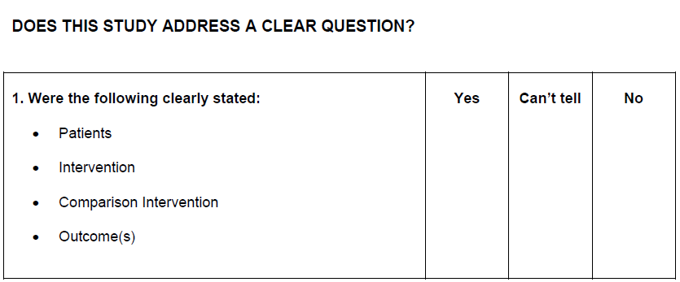
Critical appraisal

Slide 48
Critical appraisal

Slide 49
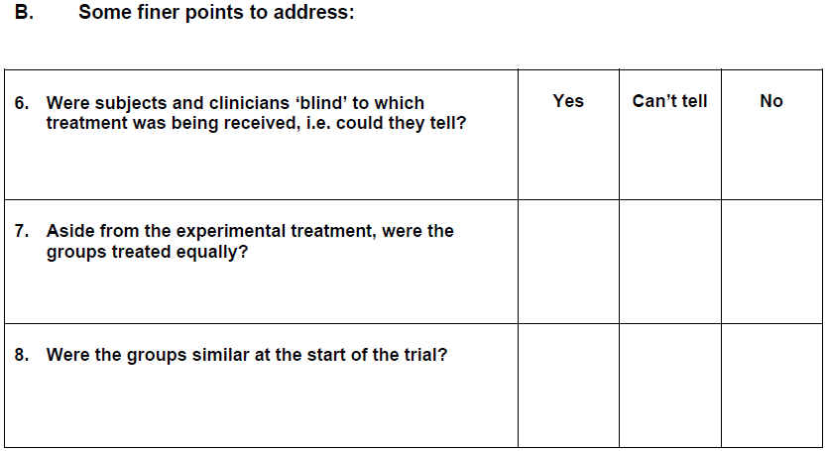
Critical appraisal

Slide 50
Critical appraisal

Slide 51
Critical appraisal

Slide 52
Thank you

